Slide 1
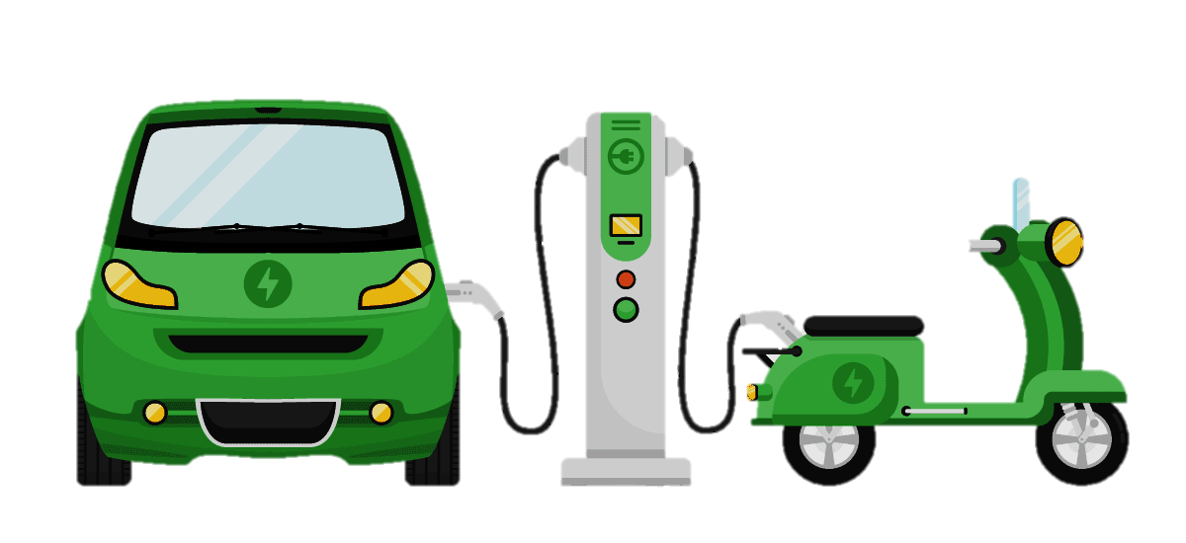
EV SALES IN INDIA
Submitted by Anupam Anil

Slide 2

Introduction
Between 2021 and 2023, India's electric vehicle (EV) market saw strong growth, driven by government incentives, rising environmental awareness, and better infrastructure. In 2021, EV sales spiked, particularly in electric two-wheelers.
This growth continued into 2022 and 2023, with more EV models entering the market, improved battery technology, and expanding charging networks. Despite challenges like high costs and limited charging infrastructure, India’s EV market is rapidly expanding, supported by both government policies and increasing consumer interest in sustainable mobility.

Slide 3
Objective
The main objective of this project is to find the trends in the sales of the Electric Vehicle in India from 2021 to 2023.
The increasing growth trends of EV market in India is clearly depicted through Charts, Graphs, etc in this PowerBi project.

Slide 4
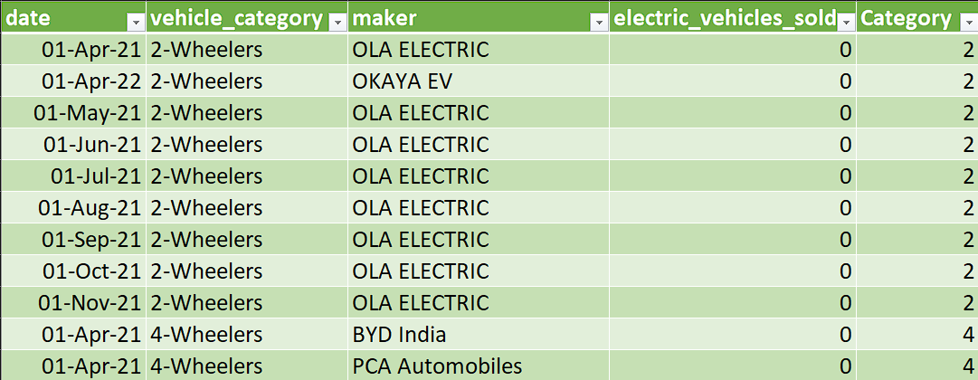
Dataset (electric_vehicle_sales_by_makers)

Slide 5
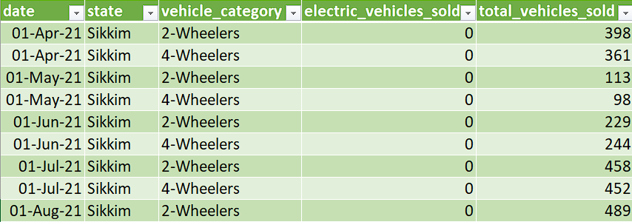
Dataset
(electric_vehicle_sales_by_state)

Slide 6
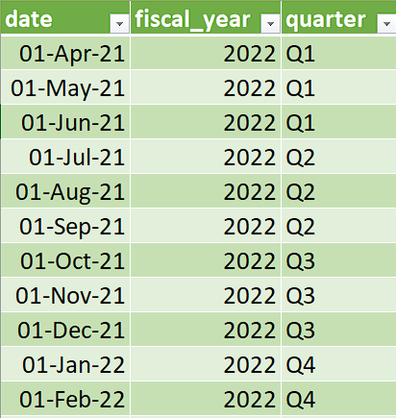
Dataset
(dim_date)

Slide 7
Key Details
There are 3 datasets used in the making of this Electric Vehicle Sales Dashboard as shown in the previous slides.
Total Entries:
1. electric_vehicle_sales_by_makers: This dataset contains 816 entries with 5 columns.
2. electric_vehicle_sales_by_state: This dataset contains 2441 entries with 5 columns.
3. dim_date: This dataset contains 36 entries with 3 columns.

Slide 8
1. electric_vehicle_sales_by_makers
1. date : The date of purchase of the vehicle.
2. vehicle_category : The category of the vehicle i.e, 2 wheeler or 4 wheeler.
3. maker : The brand who manufactures the vehicle.
4. electric_vehicles_sold : The number of EVs sold.
5. Category : 2 wheelers and 4 wheelers are categorized in numbers.

Slide 9
2. electric_vehicle_sales_by_state
1. date : The date of purchase of the vehicle.
2. state : The state in which EVs are sold.
3. vehicle_category : The category of the vehicle i.e, 2 wheeler or 4 wheeler.
4. electric_vehicles_sold : The number of EVs sold.
5. total_vehicles_sold : The number of total vehicle sales (not only EVs).

Slide 10
3. dim_date
1. date : The date of purchase of the vehicle.
2. fiscal_year : The year as reckoned for taxing or accounting purposes; a financial year
3. quarter : The quarter in the each fiscal year when purchase occurred.

Slide 11
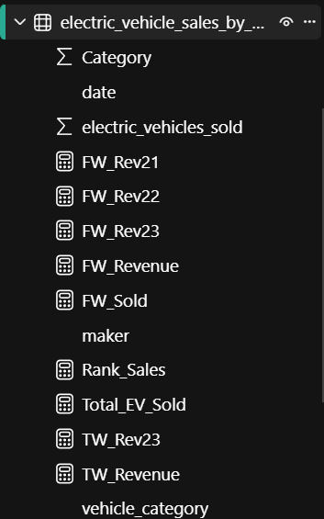
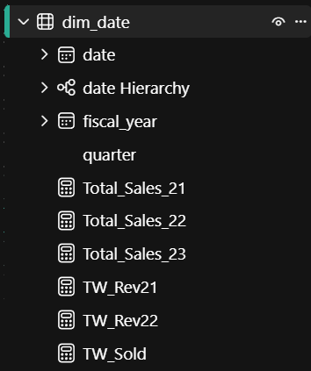

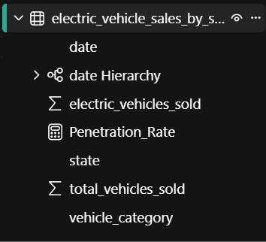
New Measures Used:
New column added

Slide 12


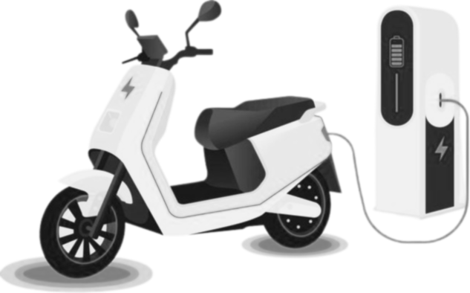


Criterias Used
Total EV Sold in Each Year
Area Chart
Total EV Sold by Makers
Bar Chart
Total EV Sold by Years
Pie Chart
Total EV Sold by State
Tree Map

Slide 13





Criterias Used
Total FW EV Sold, Total TW EV Sold
Cards
Vehicle Category, Year
Slicers
Total TW Sold
Gauge
TW Rev’23 x FW Rev’23
Donut Chart

Slide 14
DASHBOARD
EV SALES
2021 - 2023

Slide 15
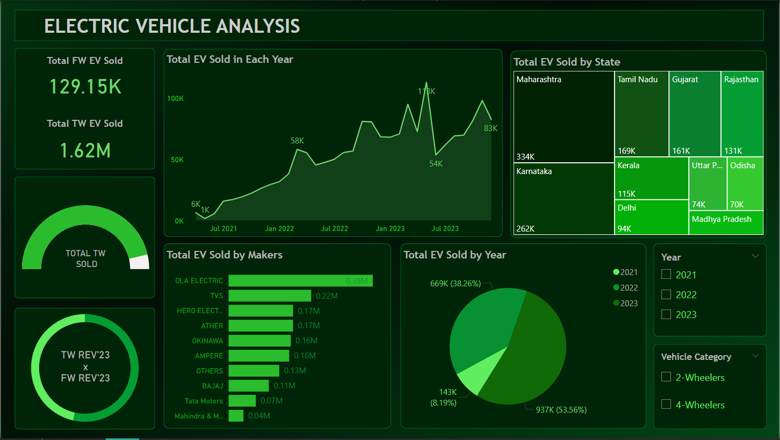

Slide 16
Conclusion
Two-wheeler dominance: From 2021 to 2023, 1.62 million electric two-wheelers were sold, significantly exceeding the 129,150 electric four-wheelers sold. This highlights the current preference for electric two-wheelers in the Indian market.
Rapid growth: The upward trend in the "Total EV Sold in Each Year" graph suggests a rapid increase in EV adoption overall.
Competitive landscape: Ola Electric leads the two-wheeler segment with 2.7L units sold in 2023, followed by TVS with 1.7L units. This indicates a competitive market with multiple players vying for market share.
Four-wheeler potential: Although the four-wheeler segment is smaller, it is still experiencing growth. The exact figures aren't visible in the image, but the overall trend suggests increasing adoption.

Slide 17
References
1. Github : https://github.com/xephyrus19/Electric-Vehicle-Market-Insights
2. Power BI - Visualisation

Slide 18
Thank You

